Slide 1


Firstname Lastname
cnet@uchicago.edu
url.uchicago.edu
Stocks Prediction
Group 5: Liang Gong, Joshua Wang, Iva Zhou, Maxine Wu, Jingxuan Li
March 2025

Slide 2
Agenda
Business Problem & Objectives
Assumptions/Hypotheses about data and/or modeling
Data Properties and EDA
Data processing (anomaly detection, cleansing and imputations) and transformations
Feature Engineering
Proposed Model Performance
Model Results and Finding
Future Work(limitation and Improvement)

Slide 3
Business Problem & Objectives
Our project aims to assess the feasibility of accurately predicting six U.S. tech company stock prices using historical price and trading data alongside fundamental indicators. We will compare traditional statistical models with deep learning approaches to evaluate their performance in different market conditions.
2

Slide 4
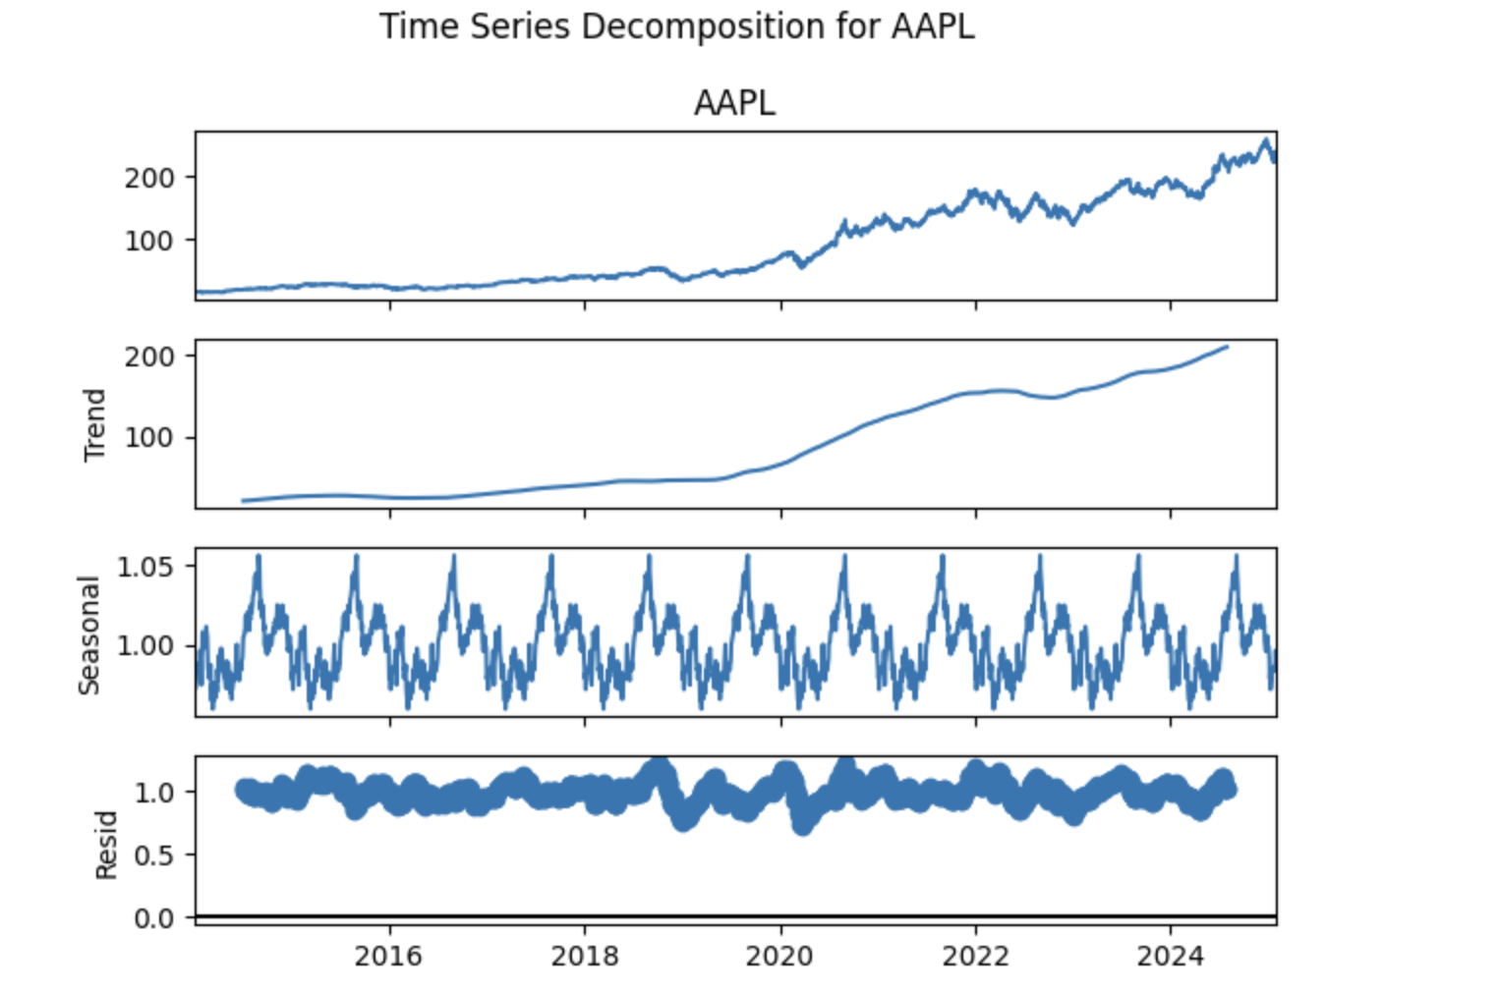
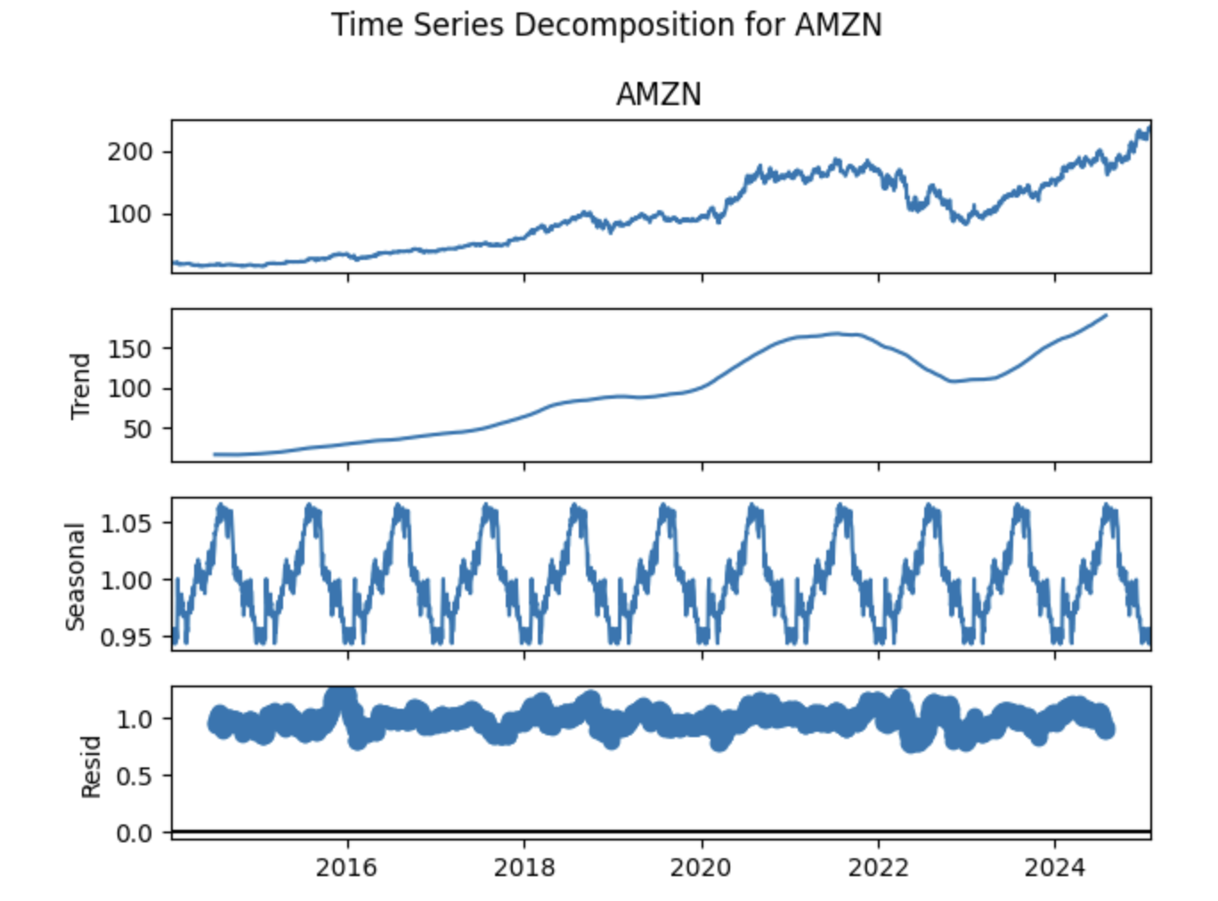
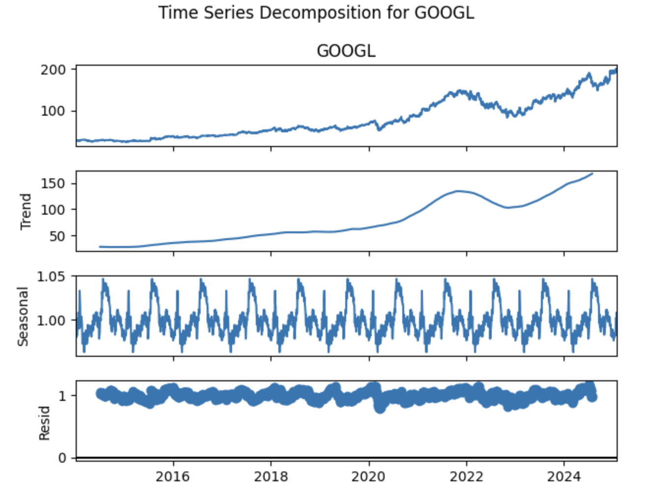
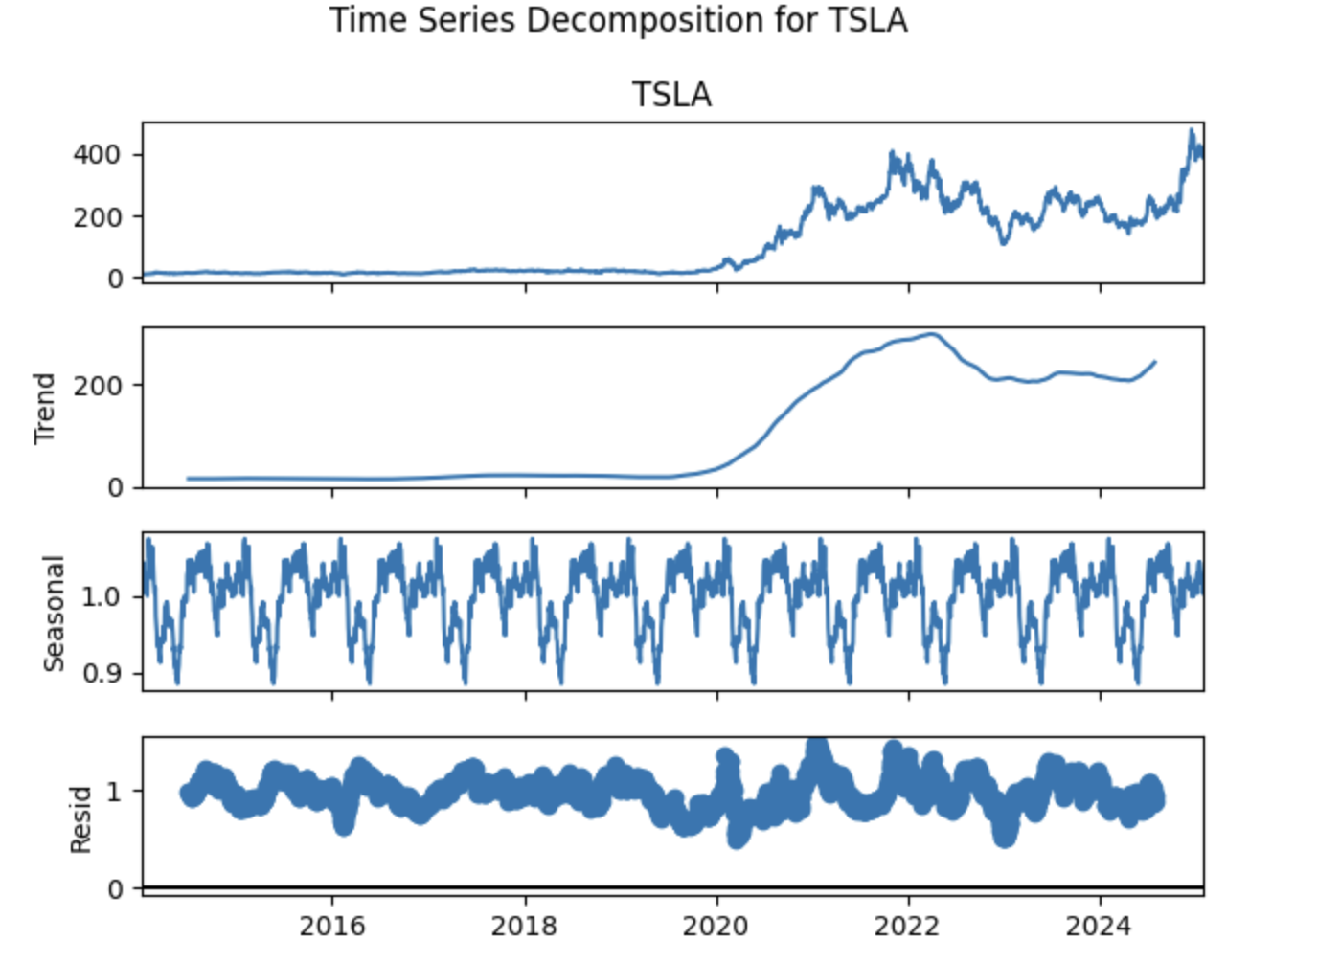
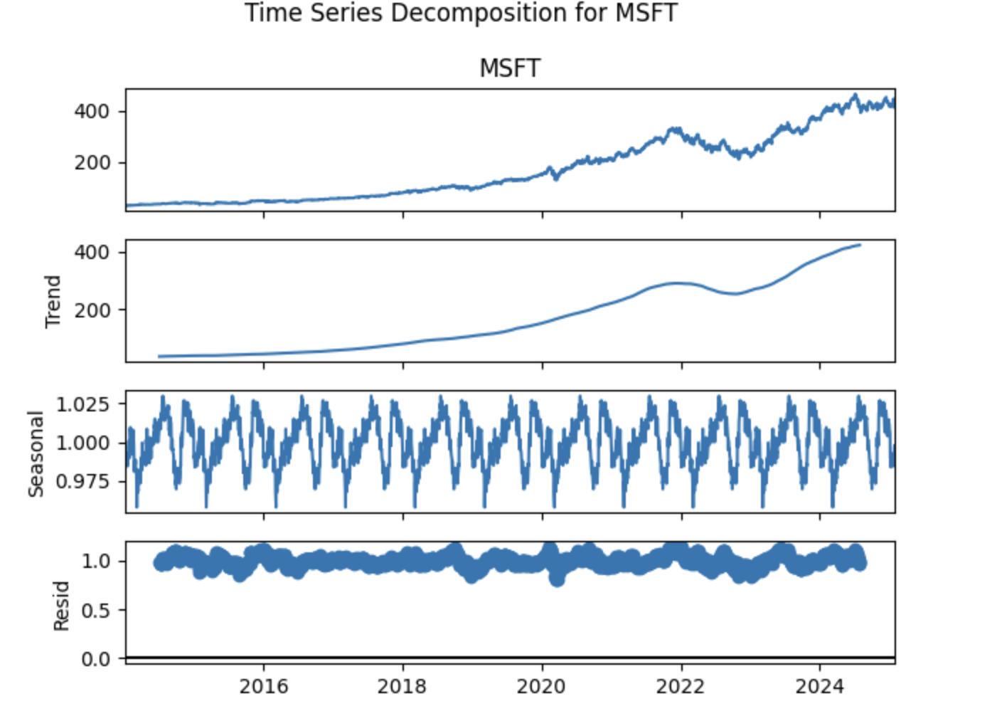
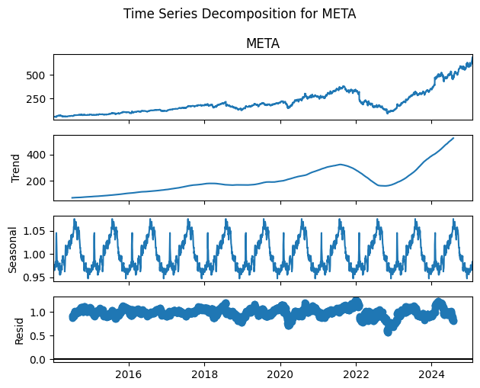
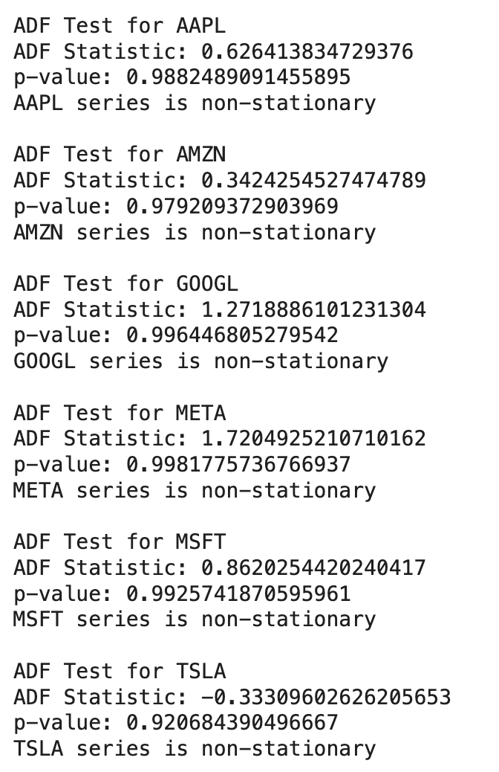
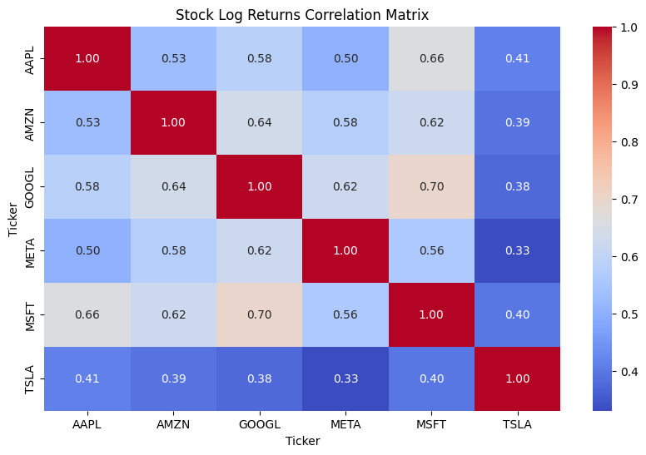
Data properties (stationarity, correlations, data distribution) and Exploratory data analysis
All stock price time series are non-stationary, as confirmed by ADF test results.
Trends and seasonal components are present, requiring transformations like differencing before modeling.
Log returns are approximately normally distributed, which is a useful property for financial modeling.
TSLA has lower correlations with other tech stocks,
Companies like GOOGL, MSFT, AMZN, and META have higher correlations.
Notes:
1. Time Series Decomposition
Each company has a time series decomposition plot, breaking down the stock price into trend, seasonality, and residual components.
The trend component for all stocks shows an upward trajectory, but the seasonality and residual components exhibit fluctuations.
This suggests non-stationarity, meaning the time series needs transformation (e.g., differencing) before applying models like ARIMA or SARIMAX.
2. ADF
The ADF test is conducted for each stock to check for stationarity.
All p-values are very high (>0.05), indicating that none of the series are stationary.
Since stationarity is an assumption for time series models, these series would require differencing or transformation before forecasting.
3. Log Returns Distribution
The log return distributions for AAPL, AMZN, GOOGL, TSLA, MSFT, and META are plotted.
The histograms show that log returns are approximately normally distributed, centered around zero, with some skewness and tails.
This suggests that returns might be modeled using Gaussian distributions, though further checks for heteroscedasticity (e.g., ARCH/GARCH models) might be necessary.

Slide 5
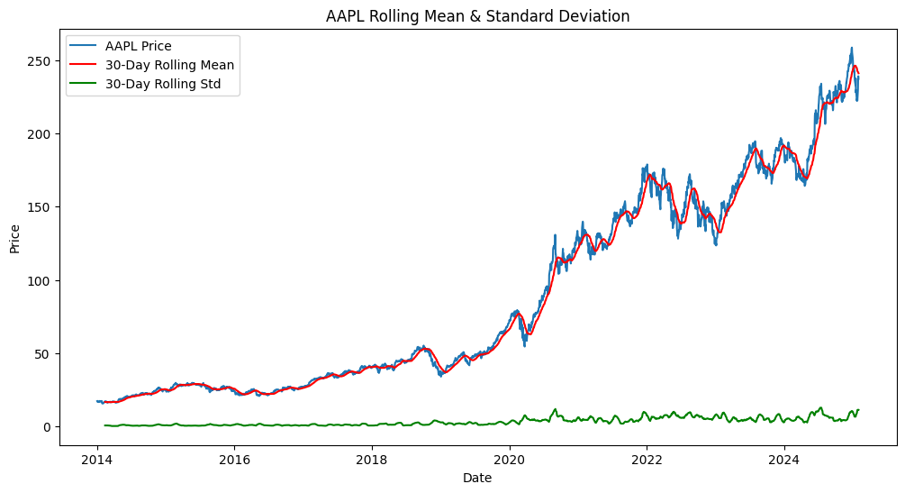
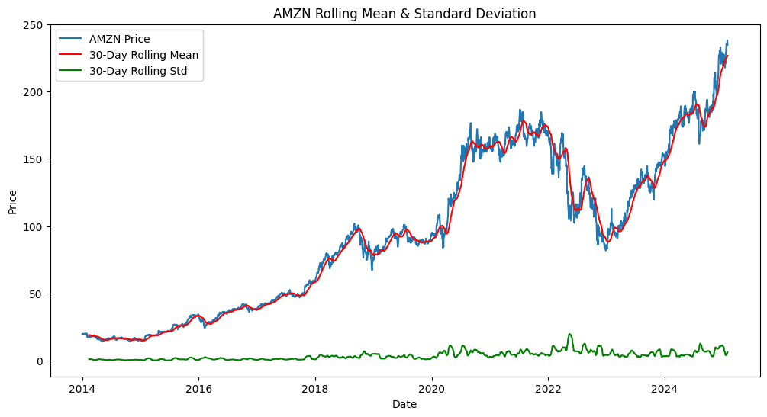
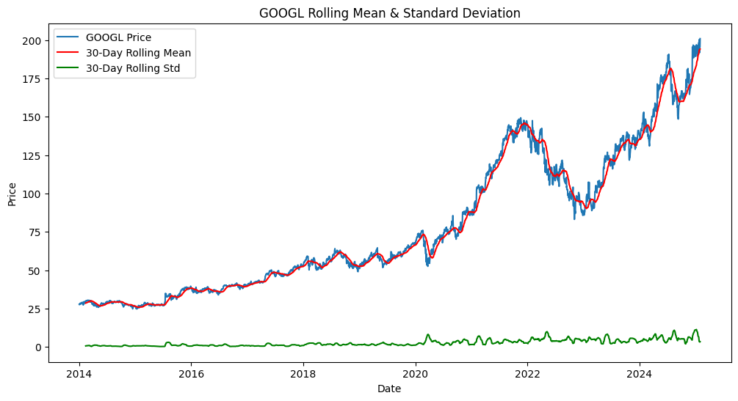
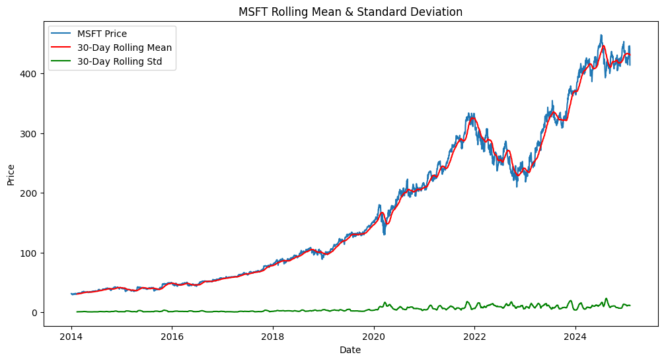
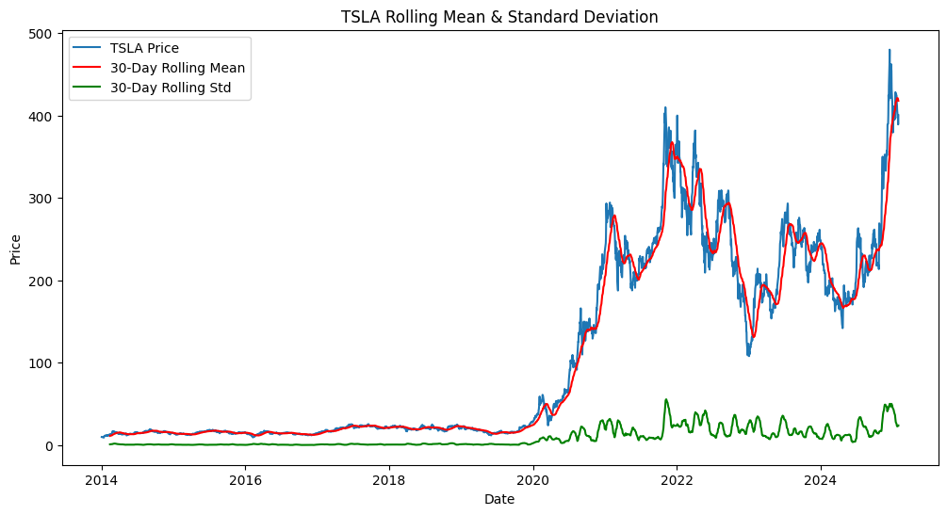
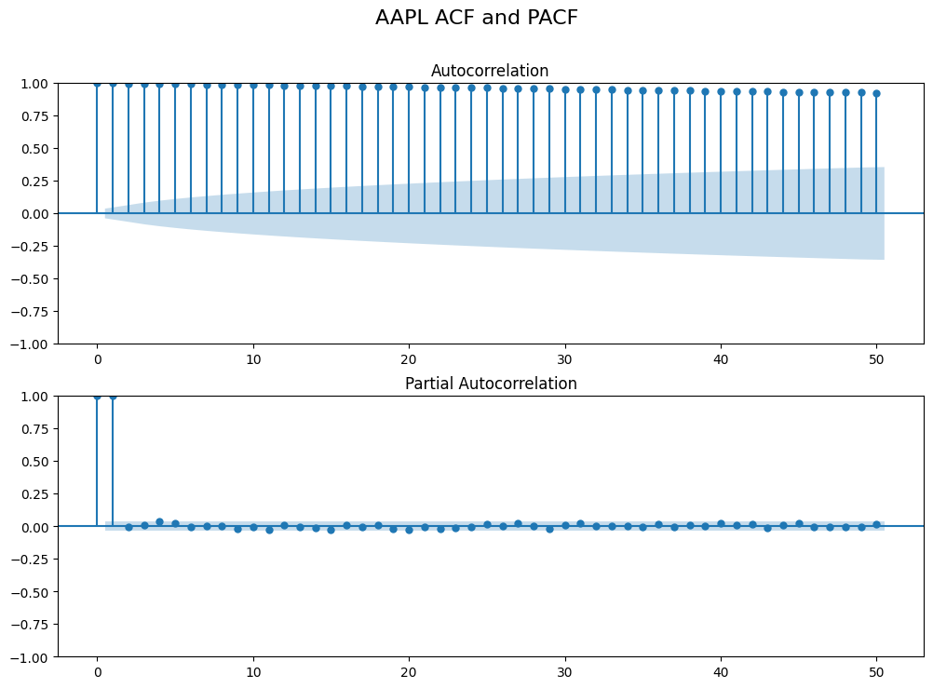
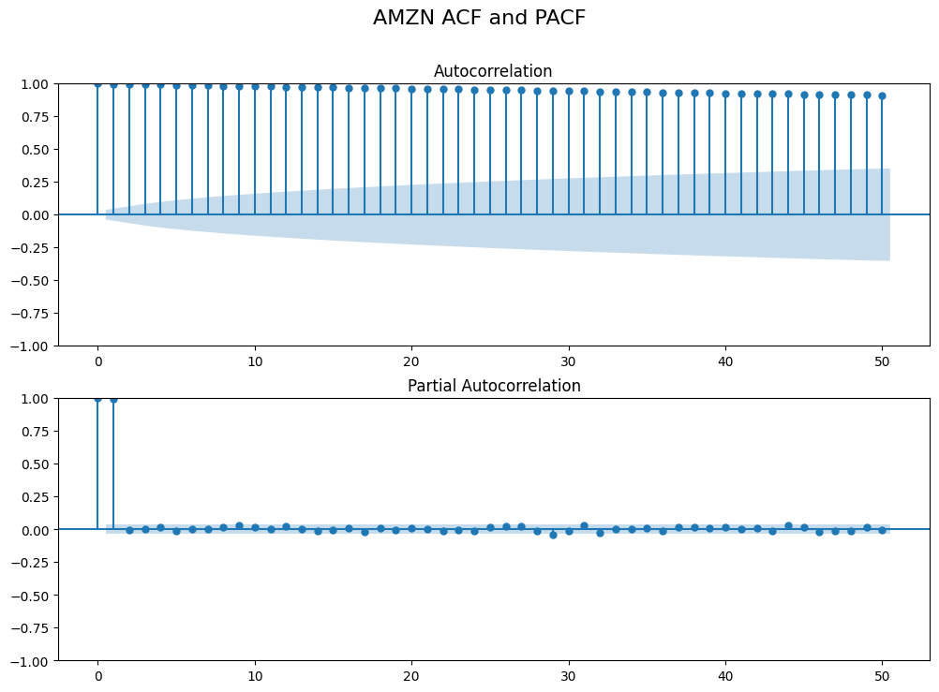


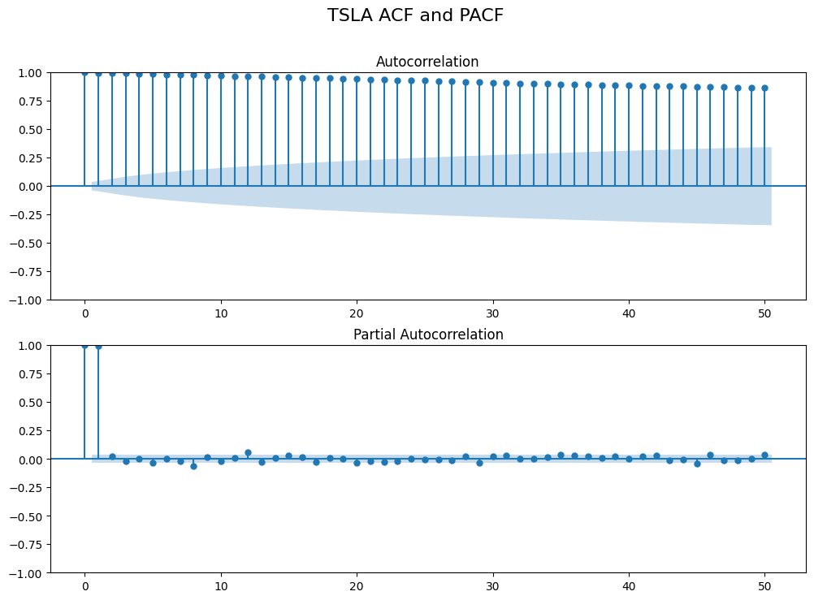
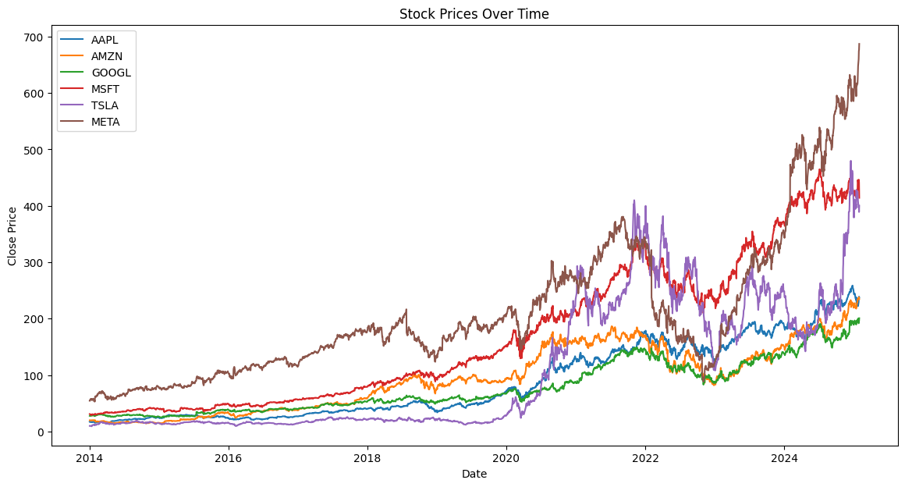
Data processing (anomaly detection, cleansing and imputations) and transformations
All stocks show strong trends & increasing volatility, indicating non-stationarity.
Transformations applied (log transform & differencing) aim to stabilize variance and ensure stationarity.
ACF & PACF plots suggest autoregressive (AR) and moving average (MA) components should be considered.
Adding market-wide indicators (S&P 500, VIX) enriches the dataset and can improve forecasting accuracy.
Notes:
1. Stock Price Trends & Standard Deviations
The first row contains time series plots showing stock price movements over time for AAPL, AMZN, GOOGL, MSFT, TSLA, and META.
Each plot includes a rolling mean and standard deviation, which helps visualize long-term trends and volatility.
The increasing trend suggests non-stationarity, meaning transformation is needed before applying time series models.
2. ACF & PACF
The second row shows ACF and PACF plots for multiple stocks.
These plots help identify lags in the time series data
The slow decay in ACF and significant spikes in PACF further confirm non-stationarity
3. Transformations & Feature Engineering
Log Transform & Differencing:
We applied a log transformation to stabilize variance.
A first-order difference is computed to remove trends and make the series stationary.
Augmenting Data with Market-Wide Indicators (S&P 500 & VIX):
The dataset is enriched by adding the S&P 500 index (^GSPC) and VIX (volatility index) (^VIX).
These macroeconomic factors provide broader market context, helping improve model predictions.
4. Stock Price Trends Over Time
This plot shows normalized stock prices for all six stocks from 2014 to 2024.
Strong upward trends confirm the presence of non-stationarity.

Slide 6
Feature engineering
Raw Features: Close, High, Low
Derived Features: Lag1, Daily Range, SMA_7, RSI, Volatility
Handling Data for Backtesting
To maintain continuity, backtest features were computed using the last few days of training data.
RSI and Volatility were computed with historical values to prevent lookahead bias.
Handling Missing Data: Forward fill (ffill) was used to propagate last known values to avoid NaNs.
Feature Scaling (Normalization): Min-Max Scaling (0 to 1) was applied per feature per ticker to standardize data for modeling. Separate scalers were stored for backtesting to prevent data leakage.
Data Validation
No NaN values remain after scaling and imputation.
Train Set: 2,808 rows, spanning 2014-01-29 to 2024-11-01.
Backtest Set: 63 rows, spanning 2024-11-05 to 2025-01-30.
Notes:
1Raw Features (Base Features from Market Data)
We started with fundamental stock price attributes for each ticker:
Close: The closing price of the stock.
High: The highest price reached during the trading session.
Low: The lowest price reached during the trading session.
2Derived Features (Lagged & Statistical Indicators)
We created additional meaningful features to capture trends and momentum:
Lag1: Previous day's closing price (helps model short-term price momentum).
Daily Range: Difference between High and Low prices (measures daily volatility).
SMA_7: 7-day Simple Moving Average of Close (tracks short-term price trends).
RSI (Relative Strength Index, 14-day): A momentum indicator that measures overbought/oversold conditions.
Volatility (20-day Standard Deviation of Close): Measures market fluctuations over a 20-day window.
3Handling Data for Backtesting
To maintain continuity, backtest features were computed using the last few days of training data.
RSI and Volatility were computed with historical values to prevent lookahead bias.
4 Handling Missing Data
Forward fill (ffill) was used to propagate last known values to avoid NaNs.
5 Feature Scaling (Normalization)
Min-Max Scaling (0 to 1) was applied per feature per ticker to standardize data for modeling.
Separate scalers were stored for backtesting to prevent data leakage.

Slide 7
Exponential Smoothing with a Recursive Sliding Window
We employ Exponential Smoothing with a Recursive Sliding Window to forecast stock prices for the next three months
Train-Test Split
Each stock’s time series is split into 80% training data and 20% testing data, ensuring that the model is evaluated on unseen data.
Recursive Forecasting Approach
A Holt-Winters Exponential Smoothing Model is applied with:
Additive trend to capture price movement over time.
Damped trend to prevent over-extrapolation.
Seasonality (63 business days ≈ 3 months) to capture recurring patterns.
A recursive forecasting mechanism is implemented where:
The predicted value is appended to the training set to continuously refine future predictions.
Small random noise is added to account for market fluctuations.
Sliding Window Forecasting Approach
A 504-business-day rolling window (~2 years) is used as the training dataset.
The model predicts 63 business days ahead, updating its forecast iteratively.
Instead of using a fixed dataset, the training set slides forward, continuously adapting to new data.
Model Evaluation & Visualization
Mean Absolute Error (MAE) and Mean Absolute Percentage Error (MAPE) are computed to assess accuracy.

Slide 8
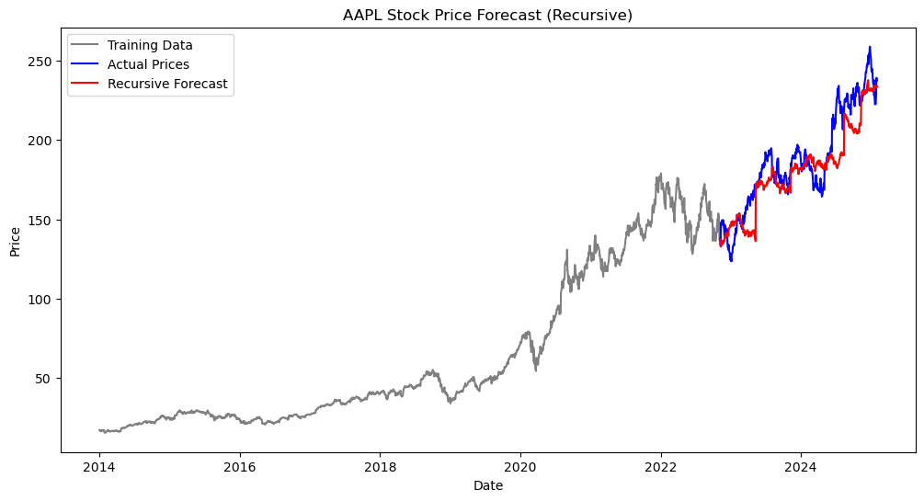
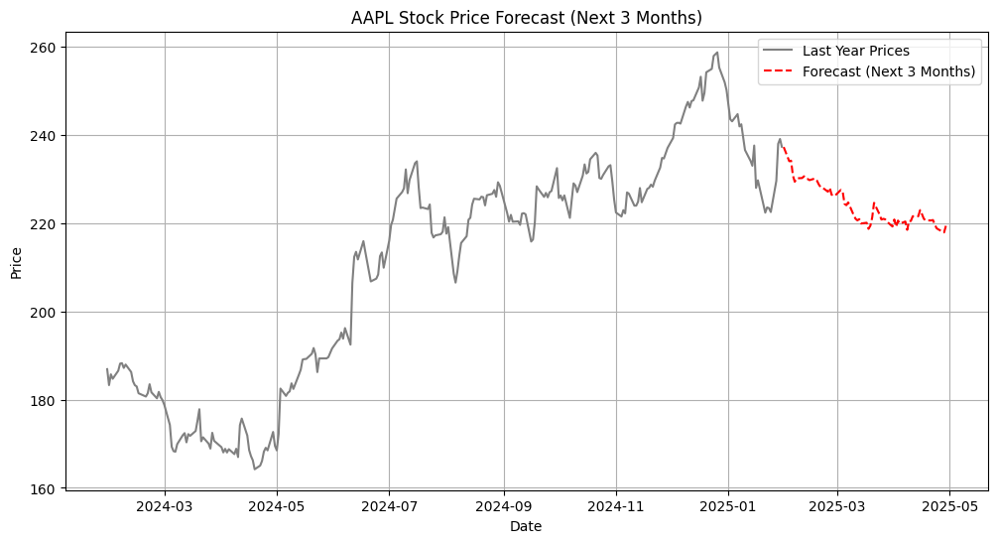
Exponential Smoothing with a Recursive Sliding Window
AAPL
Mean Absolute Error (MAE): 11.97
Mean Absolute Percentage Error (MAPE): 6.34%
MAE): 11.97

Slide 9
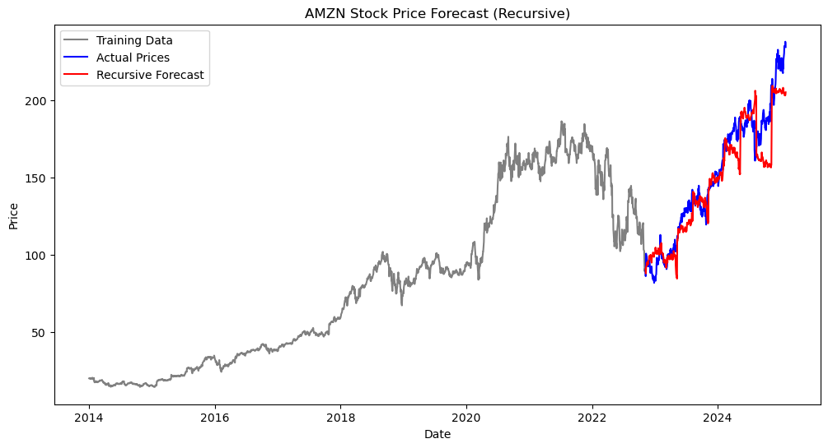
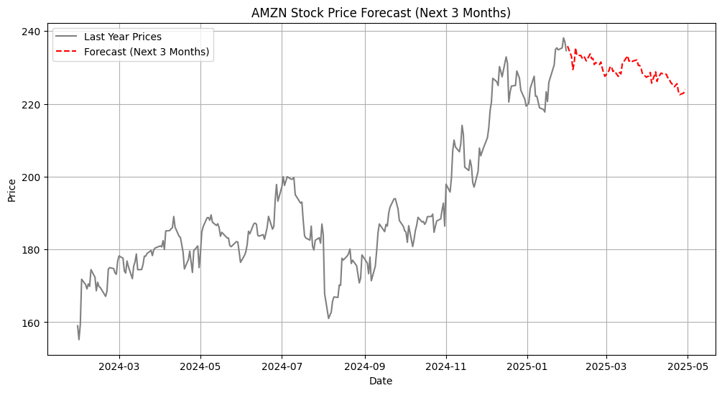
Exponential Smoothing with a Recursive Sliding Window
AMZN
Mean Absolute Error (MAE): 10.63
Mean Absolute Percentage Error (MAPE): 6.75%

Slide 10
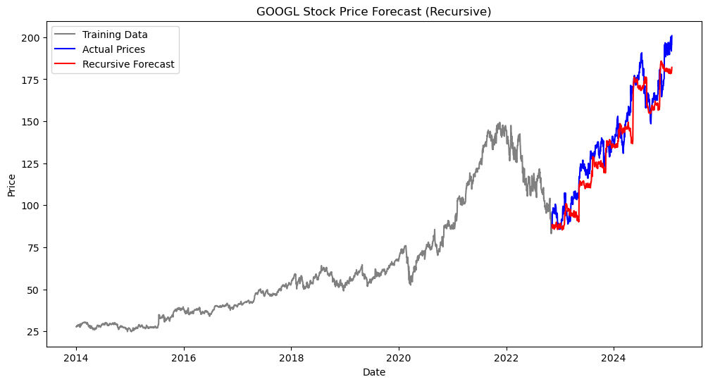
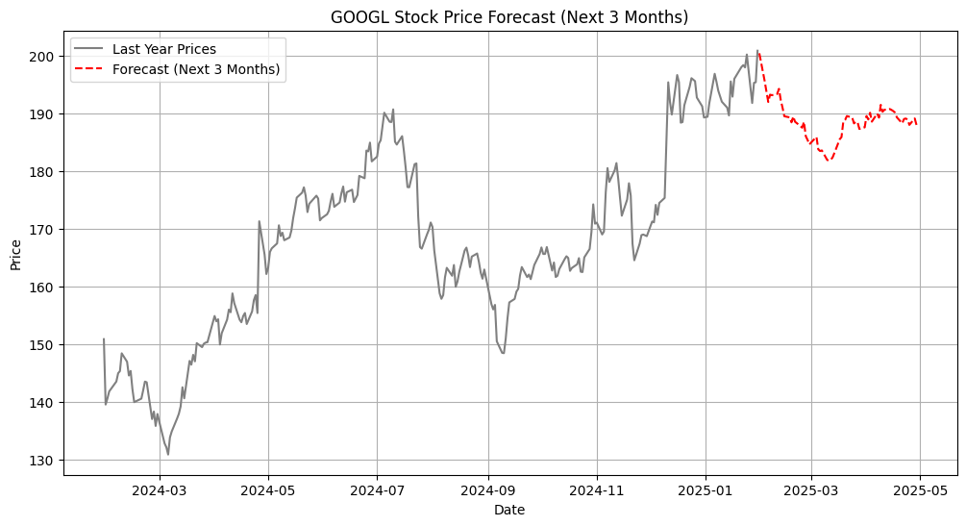
Exponential Smoothing with a Recursive Sliding Window
GOOGL
Mean Absolute Error (MAE): 8.31
Mean Absolute Percentage Error (MAPE): 6.06%

Slide 11
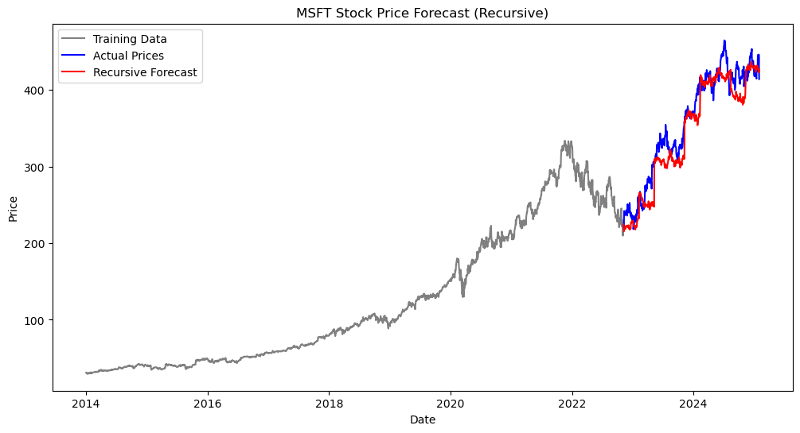
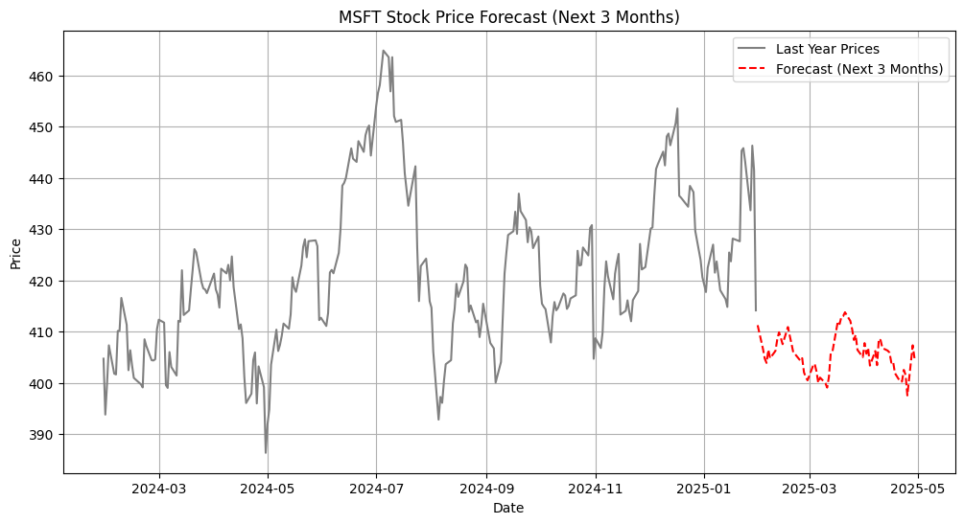
Exponential Smoothing with a Recursive Sliding Window
MSFT
Mean Absolute Error (MAE): 17.91
Mean Absolute Percentage Error (MAPE): 5.18%

Slide 12
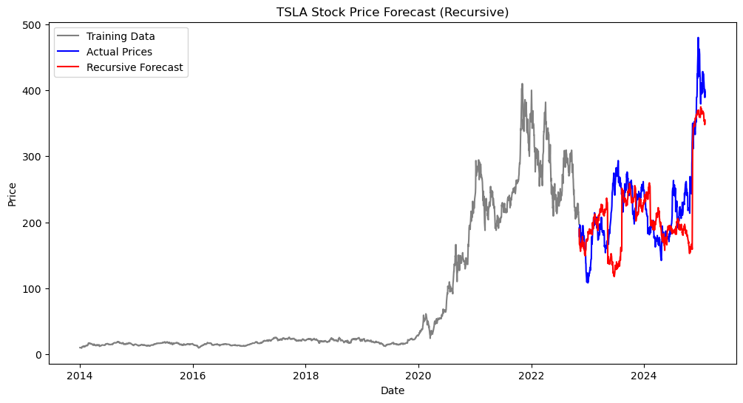
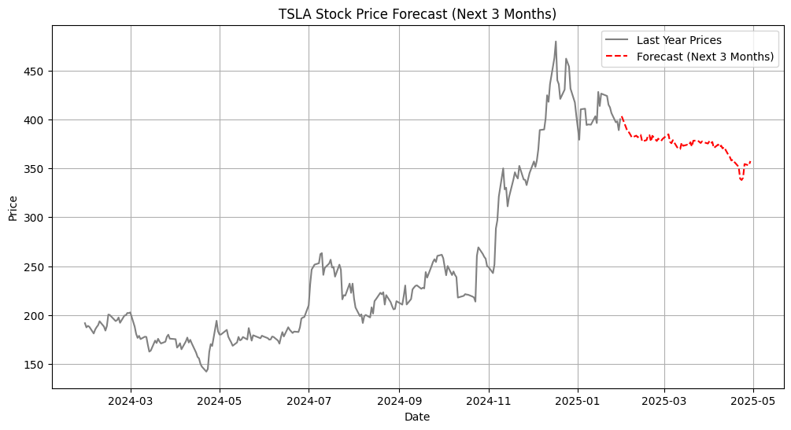
Exponential Smoothing with a Recursive Sliding Window
TSLA
Mean Absolute Error (MAE): 38.94
Mean Absolute Percentage Error (MAPE): 17.56%

Slide 13
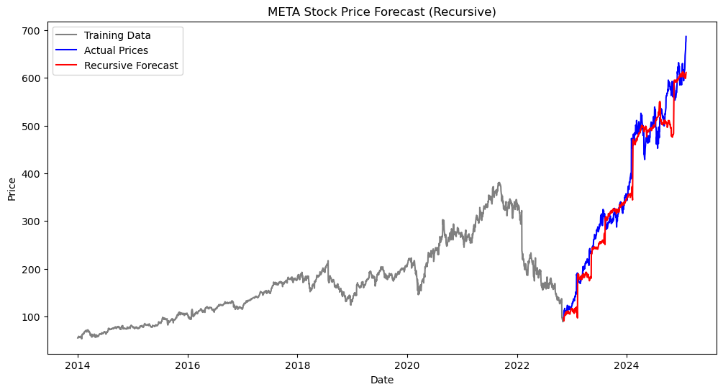
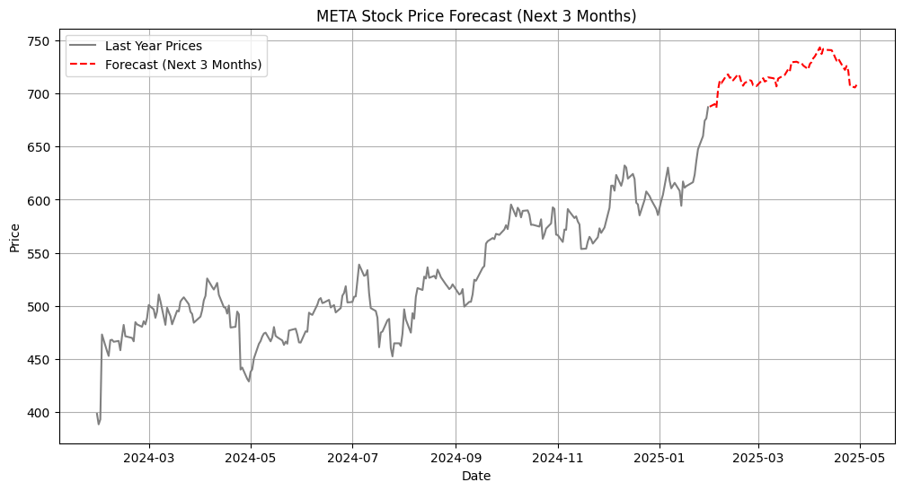
Exponential Smoothing with a Recursive Sliding Window
META
Mean Absolute Error (MAE): 25.69
Mean Absolute Percentage Error (MAPE): 7.58%

Slide 14
ARIMA & SARIMA
Assumption | ARIMA | SARIMA
Stationarity | ✅ | ✅
Linearity | ✅ | ✅
No Seasonality | ✅ | ❌Explicitly Modeled
White Noise Residuals | ✅ | ✅also seasonal residuals
Independent Errors | ✅ | ✅
No Structural Breaks | ✅ | ✅
ARIMA considers past stock prices (AutoRegressive component - AR) and past errors (Moving Average component - MA) to make predictions. ARIMA works well for short-term stock price prediction when historical prices exhibit clear trends and no strong seasonal effects.
SARIMA extends ARIMA by incorporating seasonality, making it useful when stock prices exhibit recurring patterns over time.SARIMA can handle longer timeframes when seasonal effects influence stock movements.

Slide 15
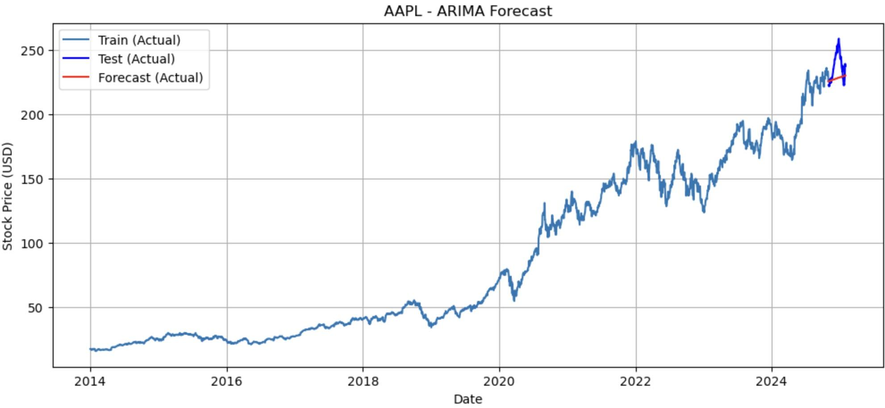
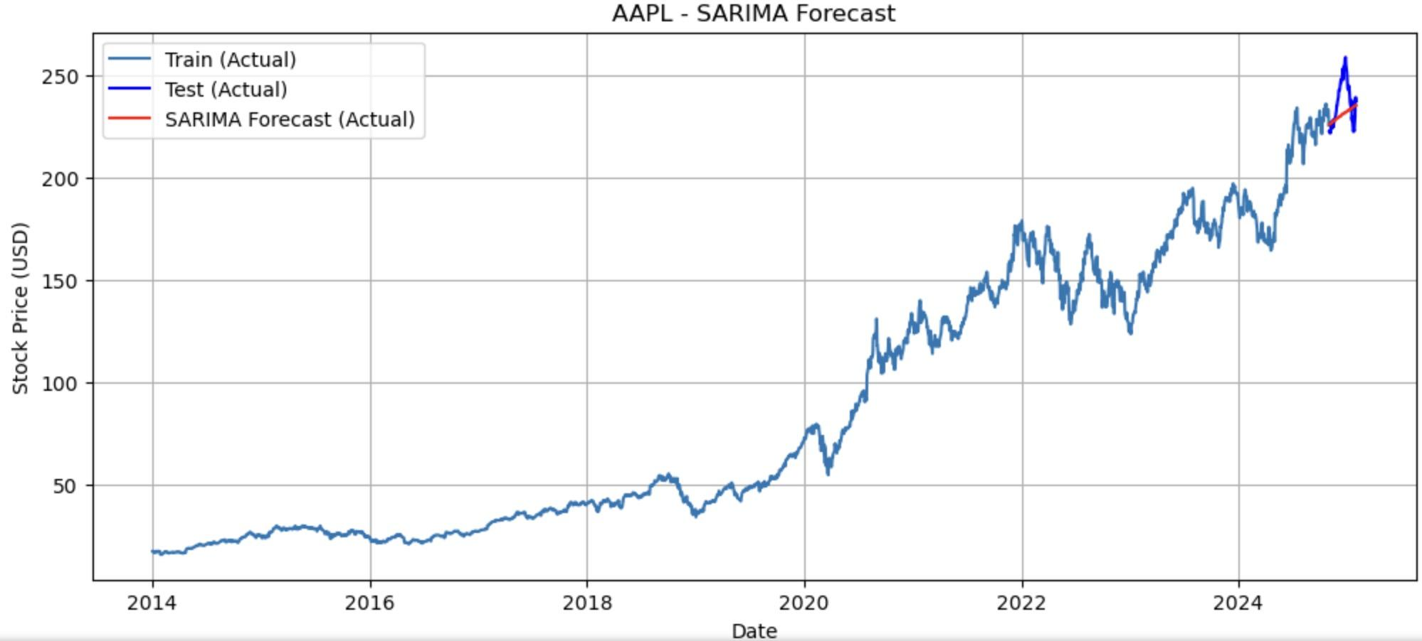
ARIMA & SARIMA
AAPL - Forecast RMSE after differencing: 14.10
AAPL - SARIMA RMSE after differencing: 12.21

Slide 16
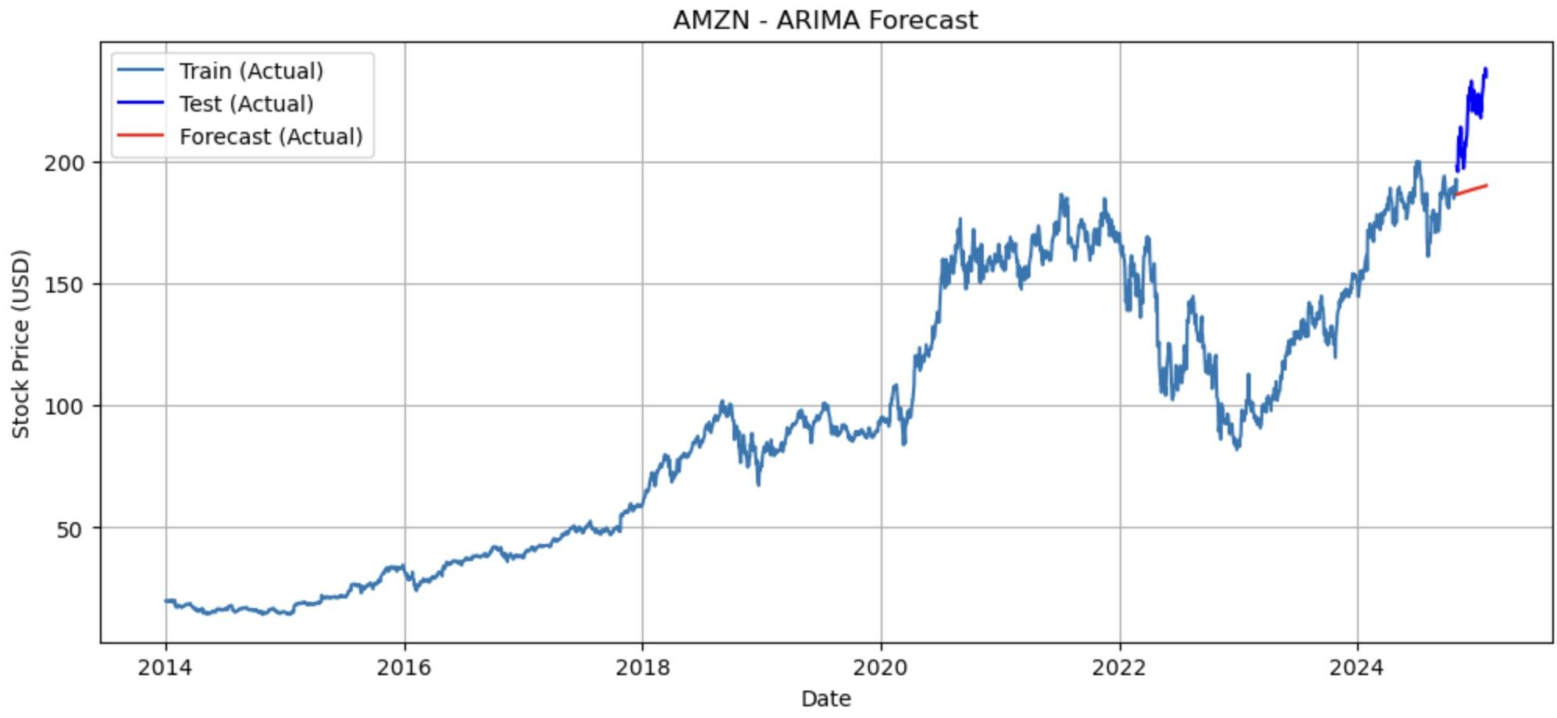
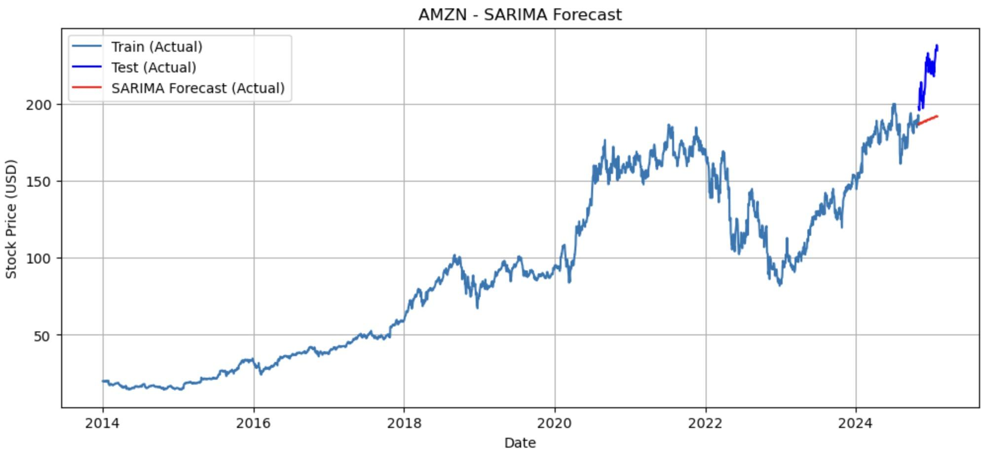
ARIMA & SARIMA
AMZN - ARIMA RMSE: 32.26
AMZN - SARIMA RMSE: 31.03

Slide 17
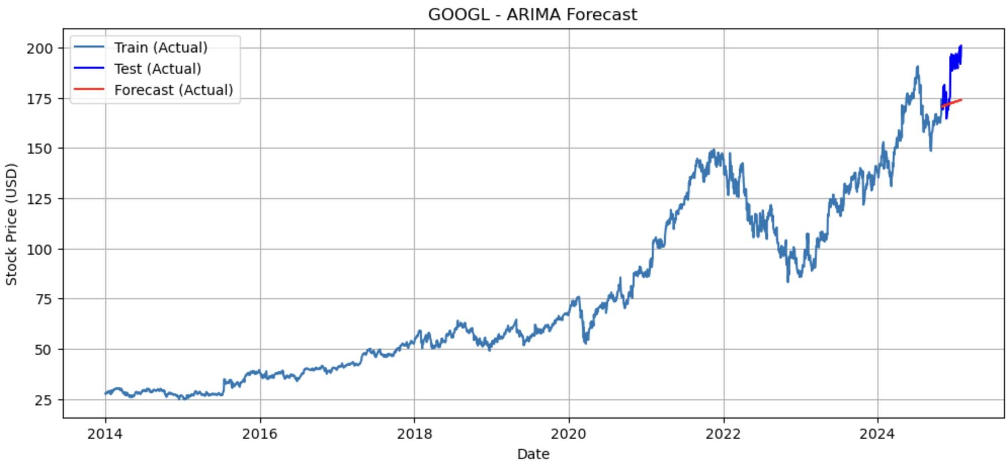
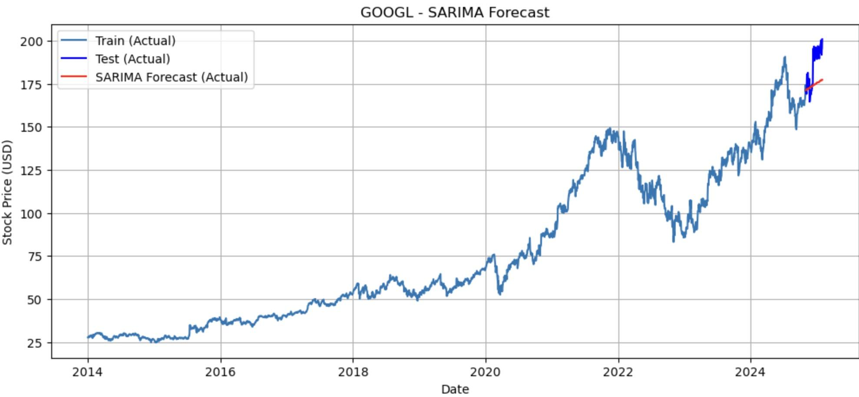
ARIMA & SARIMA
GOOGL - ARIMA RMSE: 16.10
GOOGL - SARIMA RMSE: 14.12

Slide 18
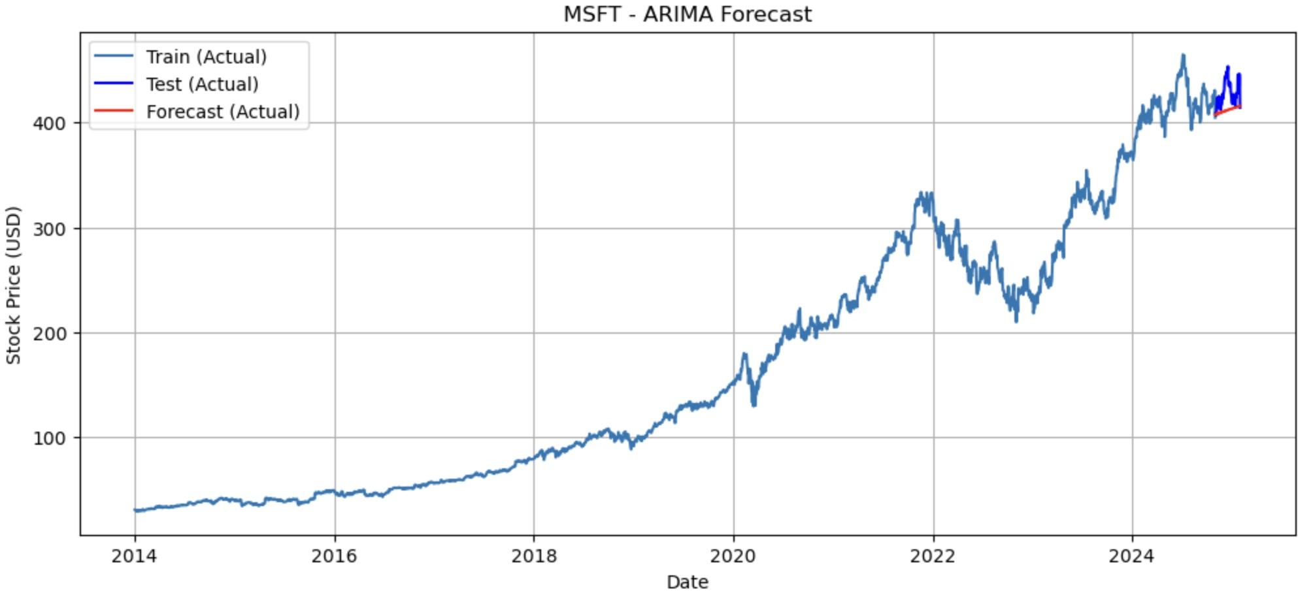
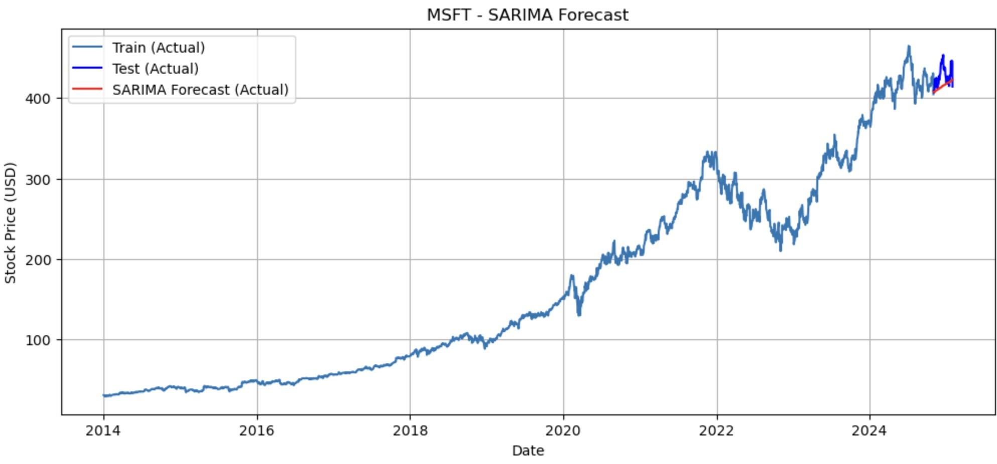
ARIMA & SARIMA
MSFT - ARIMA RMSE: 20.06
MSFT - SARIMA RMSE: 17.46

Slide 19
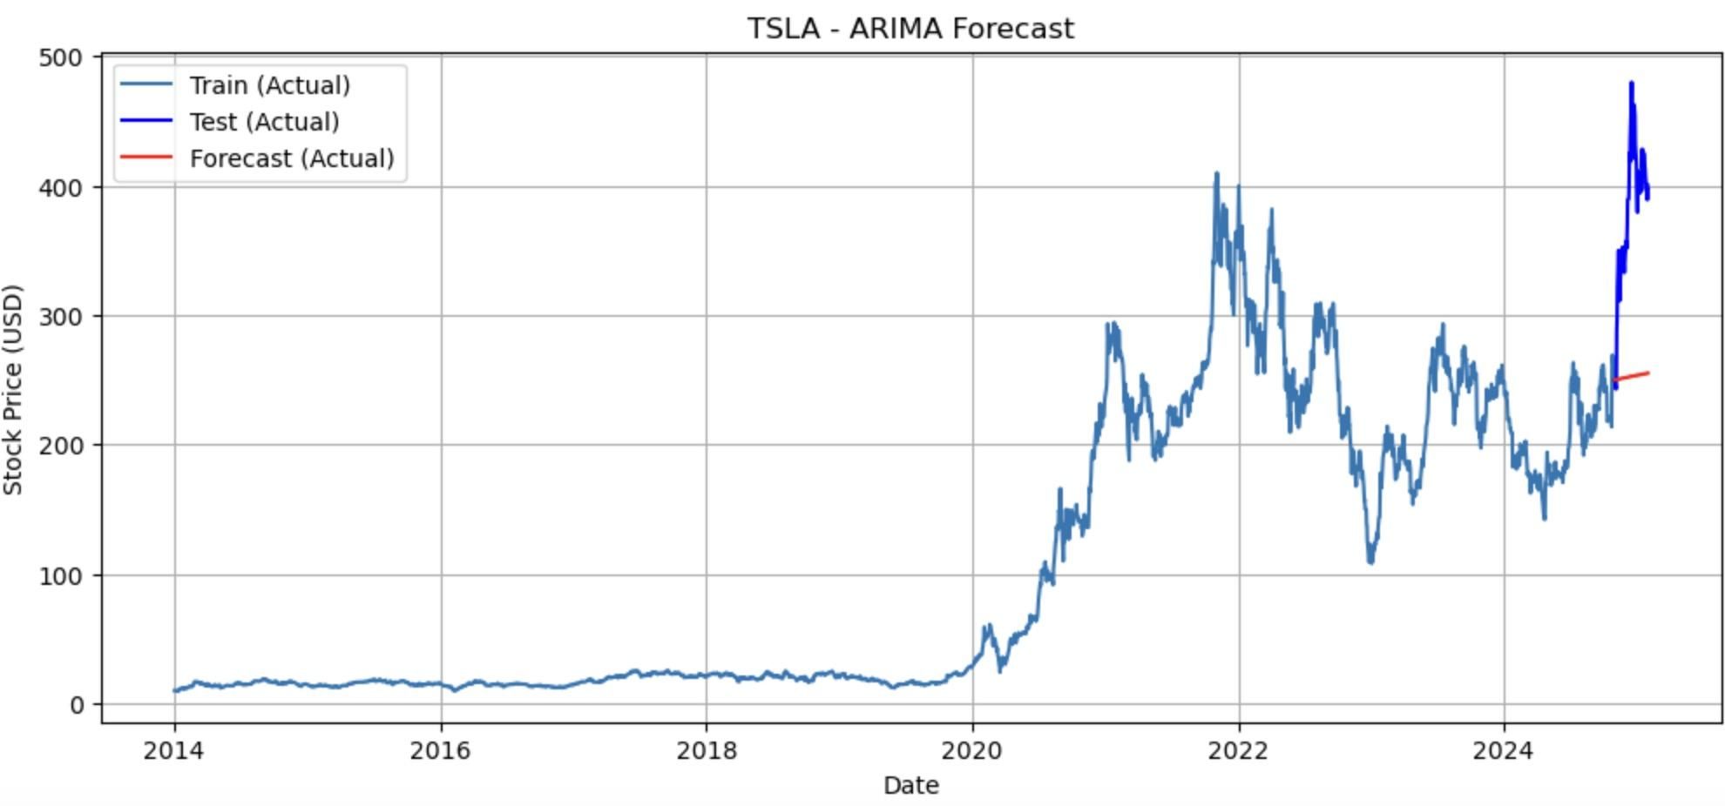
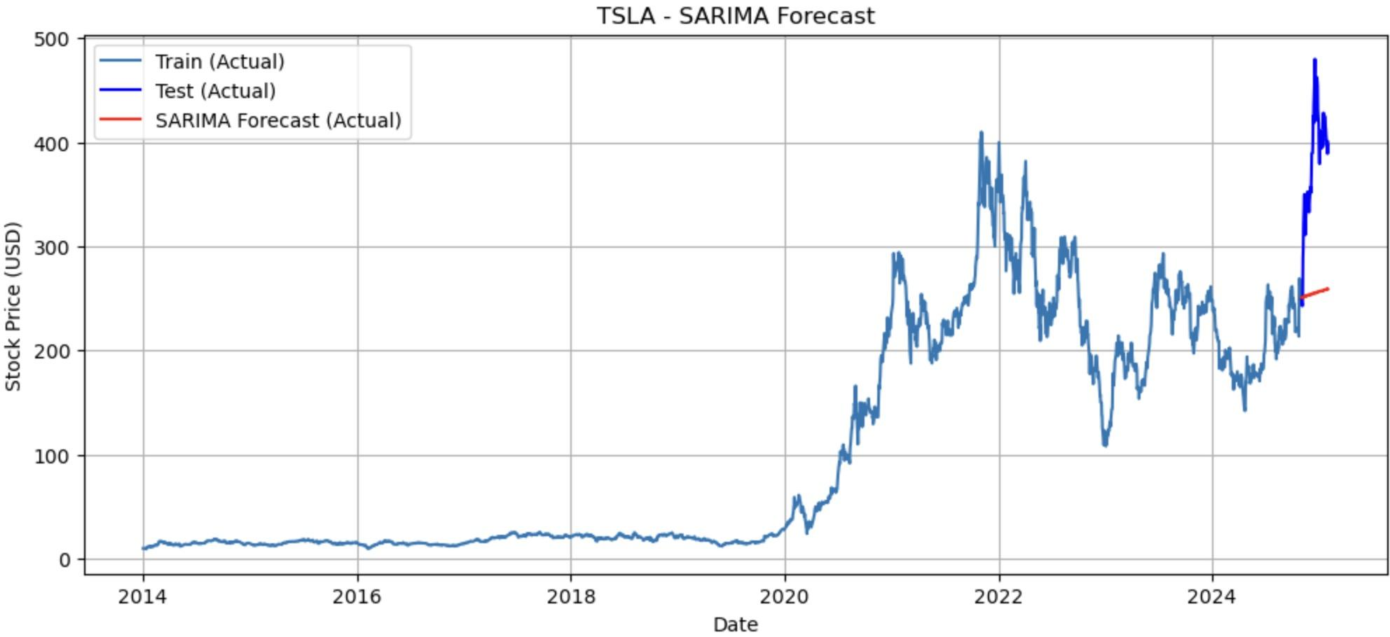
ARIMA & SARIMA
TSLA - ARIMA RMSE: 137.52
TSLA - SARIMA RMSE: 134.94

Slide 20
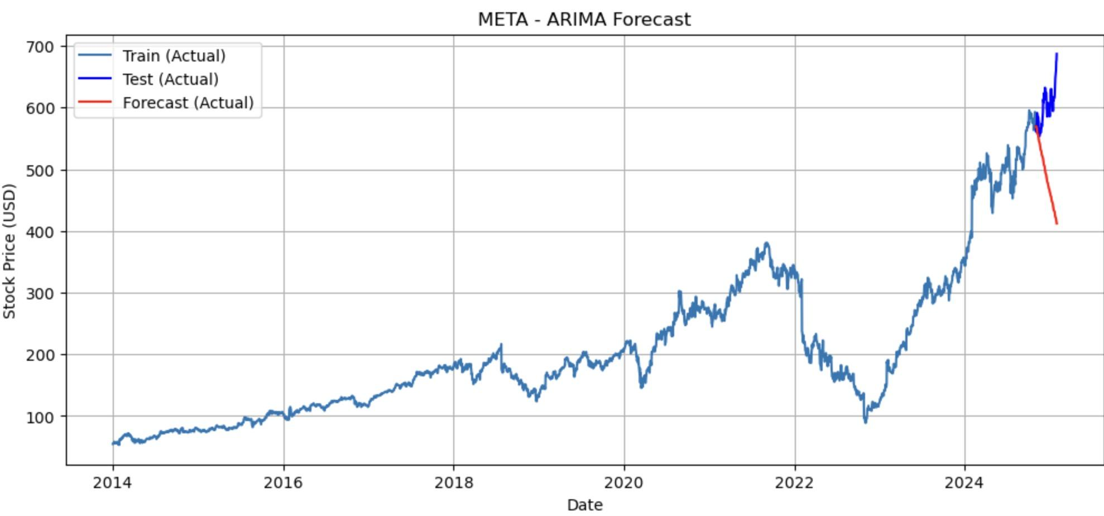
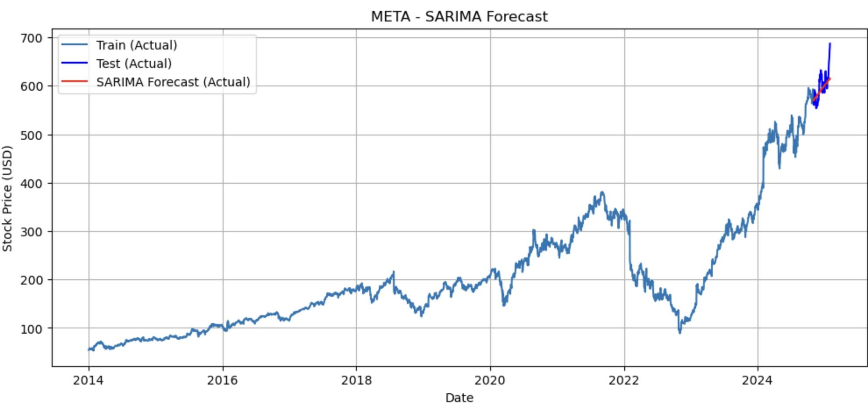
ARIMA & SARIMA
META - ARIMA RMSE: 131.72
META - SARIMA RMSE: 23.57

Slide 21

ARIMA & SARIMA
Limitations of ARIMA and SARIMA for Stock Prediction
Assumption of Linearity
ARIMA and SARIMA assume that stock price movements follow a linear pattern, which is not always true due to market shocks, news, and external factors.
Limited in Capturing Volatility
Stock markets are highly volatile. ARIMA/SARIMA models do not capture volatility clustering like GARCH models.
Not Suitable for High-Frequency Trading
ARIMA and SARIMA are designed for daily, weekly, or monthly predictions. For high-frequency trading (e.g., minute-level or tick data), deep learning models (LSTMs, Transformers) or reinforcement learning approaches work better.
Best Predictability (RMSE < 15): Apple(12.21),Goggle (14.12)
Moderate Predictability (RMSE 15 - 30): Microsoft(17.46), Meta(23.57),
Low Predictability (RMSE > 30): Amazon(31.03), TSLA (134.94)
In our result, SARIMA model always performs better than ARIMA model!

Slide 22
ARCH/GARCH
Proposed Approaches & Justification: ARCH/GARCH Model for Autodesk Stock Volatility Prediction
ARCH (Autoregressive Conditional Heteroskedasticity): Captures short-term volatility clustering but does not account for persistence. Best for one-step-ahead volatility forecasting in this test set, likely due to its simplicity and fit to noisy squared returns.
GARCH (Generalized ARCH): Adds lagged volatility terms, improving long-term volatility modeling. Best at capturing the overall volatility process (most normal residuals per JB Test) and dynamic patterns (smoother rolling predictions), due to its flexibility and longer memory.
Trade-offs: ARCH is simpler but may not fully capture volatility persistence, while GARCH is more effective but computationally intensive.
Goals: For short-term volatility forecasts (e.g., risk management), ARCH(1) might be preferred. For understanding or simulating the full volatility process, GARCH(2,2) is better for realistic long-term forecasts.
ARCH and GARCH models assume that the variance of the error term (or innovations) is not constant over time but rather autocorrelated, meaning that periods of high volatility tend to cluster together.
Results & Key Learnings
Models Evaluated: ARCH(1), ARCH(2), GARCH(1,1), and GARCH(2,2).
Best Model: GARCH(2,2) had the lowest RMSE (12.70), outperforming others.
Insights: GARCH models better predict financial market volatility, confirming that past volatility influences future volatility.
Application: Useful for risk management and options pricing.
Notes:
ARCH(1): Best for one-step-ahead volatility forecasting in this test set (lowest RMSE), likely due to its simplicity and fit to noisy squared returns.
GARCH(2,2): Best at capturing the overall volatility process (most normal residuals per JB Test) and dynamic patterns (smoother rolling predictions), due to its flexibility and longer memory.
The zero-mean assumption doesn’t cause the discrepancy; it’s a standard setup for financial data and affects all models the same way
In practice, model choice depends on your goal:
For short-term volatility forecasts (e.g., risk management), ARCH(1) might be preferred.
For understanding or simulating the full volatility process, GARCH(2,2) is better for realistic long-term forecasts.
The key here is no single model is "best" universally—performance varies by metric and context. The model choice depends on what you’re aiming for—short-term accuracy or understanding overall volatility.

Slide 23
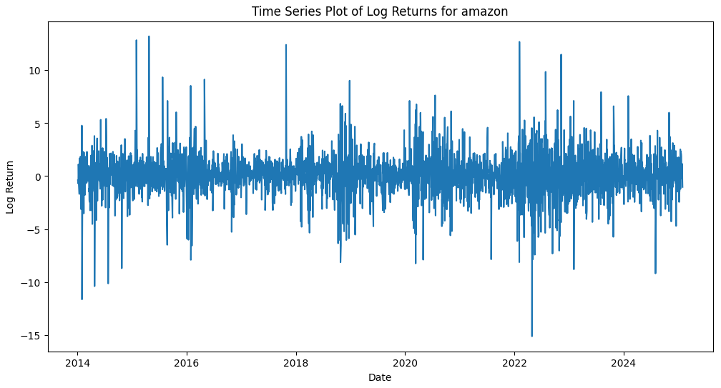
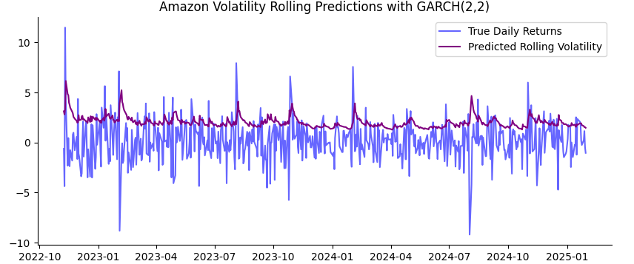
ARCH/GARCH
Amazon
RMSE amazon: 9.6

Slide 24
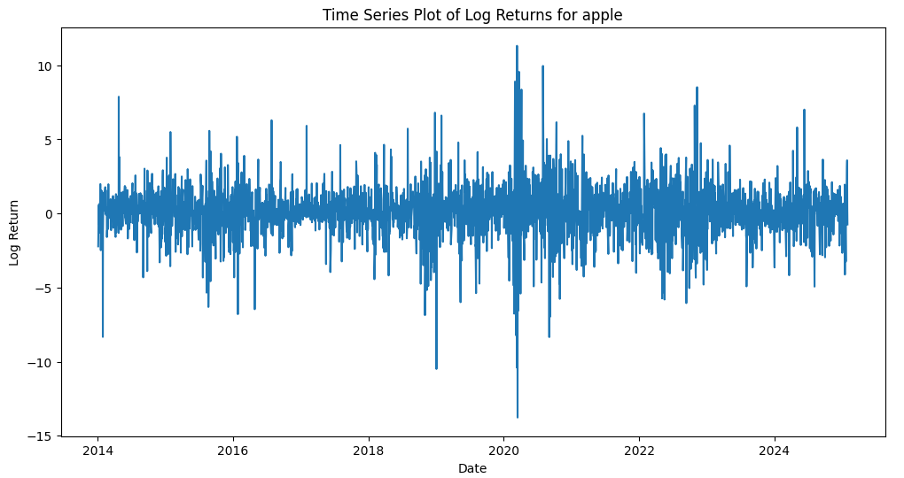
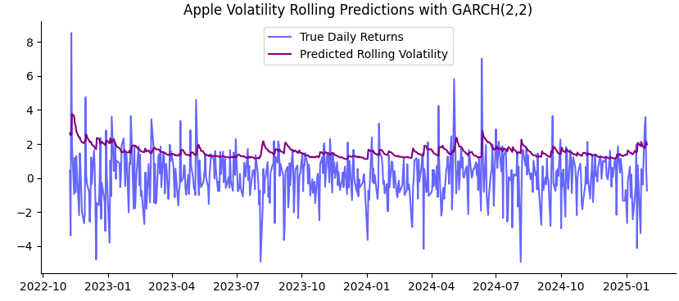
ARCH/GARCH
Apple
RMSE RMSE apple: 5.2

Slide 25
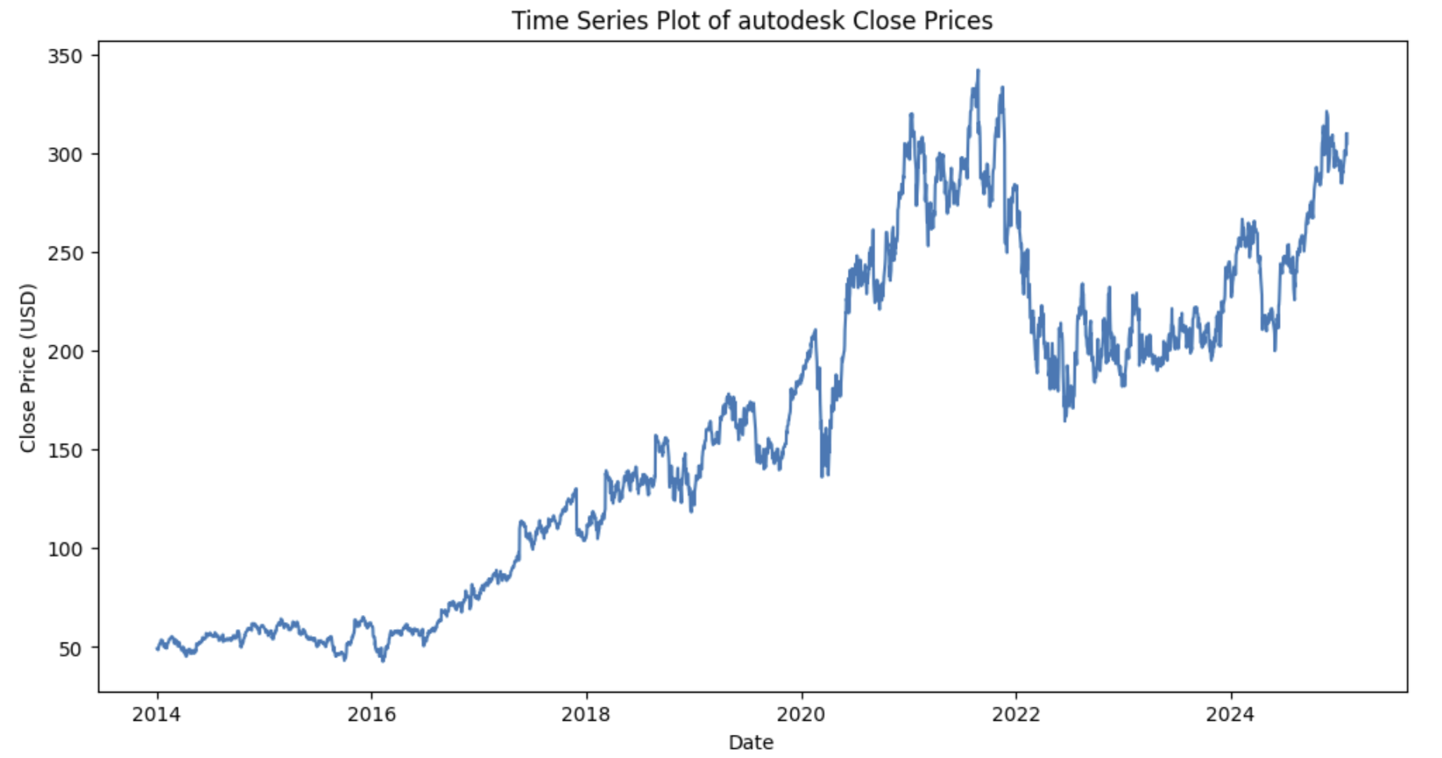
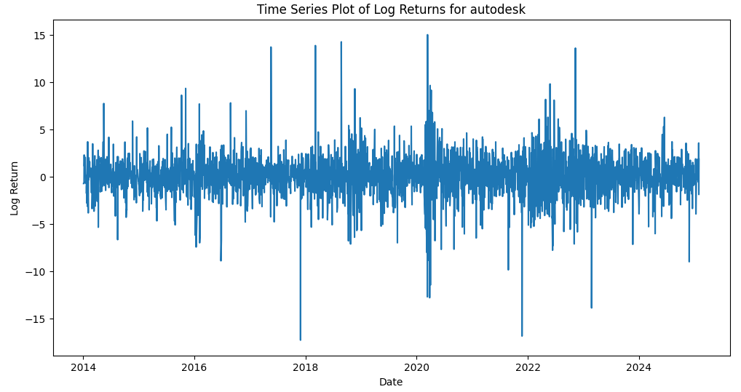
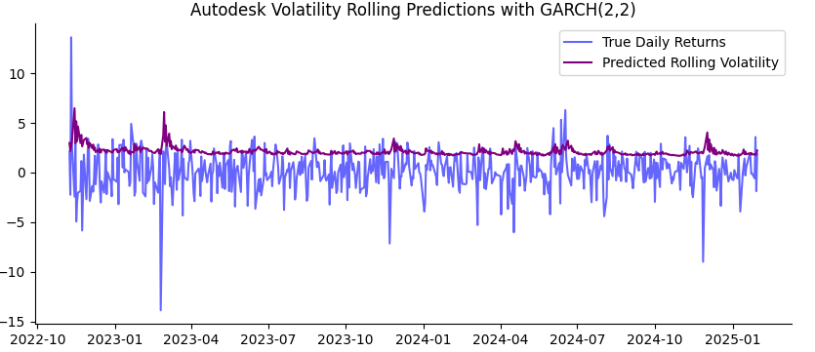
ARCH/GARCH
Autodesk
RMSE autodesk: 12.7

Slide 26
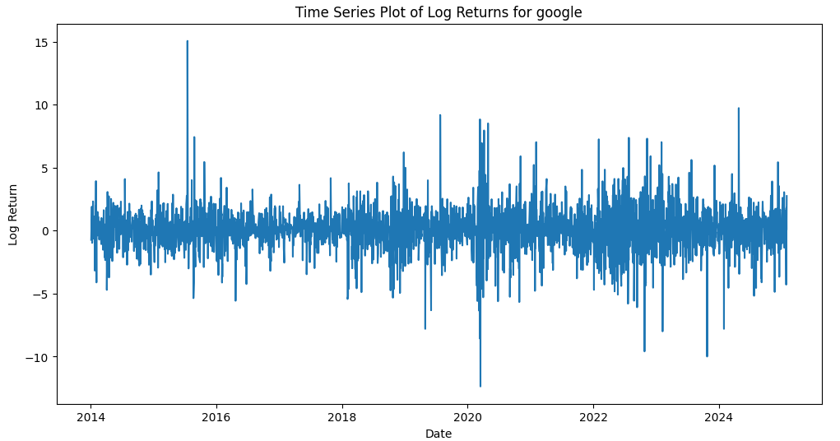
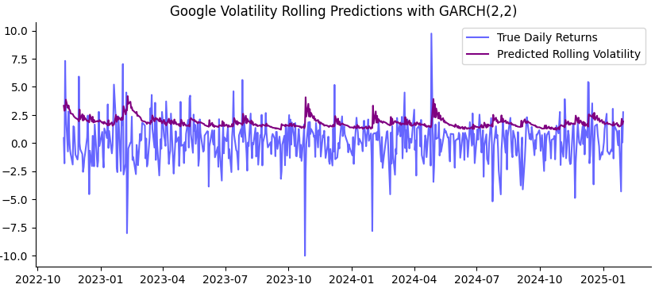
ARCH/GARCH
Google
RMSE google: 8.7

Slide 27


ARCH/GARCH
Meta
RMSE Meta: 155.5

Slide 28


ARCH/GARCH
Microsoft
RMSE microsoft: 5.1

Slide 29


ARCH/GARCH
Tesla
RMSE tesla: 29.9

Slide 30
ARCH/GARCH
Why the red peaks are always a little behind the real blue peaks?
The red peaks (predicted volatility) lag behind the blue peaks (true returns) because GARCH models predict conditional volatility based on past squared returns. This means:
GARCH reacts to past spikes, updating predictions only after observing large changes.
Volatility clustering effect: When a large return occurs, GARCH adjusts upward in the next periods, causing a delayed response.
Rolling forecast smooths out volatility, further shifting peaks.
A possible fix is to use EGARCH (which captures asymmetric shocks faster) or shorten the rolling window to make predictions more responsive.
Next Steps
Handling of Outliers or Extreme Volatility
- The Jarque-Bera test shows high test statistics and near-zero p-values, meaning the residuals are not normally distributed:
- This suggests heavy-tailed residuals, which indicate outliers or extreme volatility clustering.
✔ Try an alternative volatility model like EGARCH or TGARCH, which might better handle asymmetric volatility.
✔ Consider removing outliers or using a rolling window approach to mitigate extreme values.

Slide 31


XGBOOST by GenAI
Apple

Slide 32


XGBOOST by GenAI
Amazon

Slide 33


XGBOOST by GenAI
Autodesk

Slide 34


XGBOOST by GenAI
Google

Slide 35


XGBOOST by GenAI
Meta

Slide 36


XGBOOST by GenAI
Microsoft

Slide 37


XGBOOST by GenAI
Tesla

Slide 38
XGBOOST by GenAI
Model & Justification
XGBoost Regression for time-series forecasting.
Pros: Fast, robust, handles structured data well.
Cons: Limited sequential memory, struggles with long-term dependencies.
Results & Learnings
RMSE: 16.04 – improved accuracy over previous models.
Train Predictions (cyan dashed line): Closely follow actual trends.
Test Predictions (red dashed line): Capture movements but miss sharp trend shifts.
Future Predictions (green dashed line): Show expected movement but may be overly smoothed.
Key Improvements
Better Feature Engineering: Add RSI, Bollinger Bands.
Hybrid Model: Combine XGBoost with LSTM for sequence learning.
Dynamic Future Forecasting: Improve trend adaptability with updated feature calculations.
Hyperparameter Tuning: Optimize tree depth, learning rate.

Slide 39

LSTM - Mechanism
LSTMs are a type of recurrent neural network (RNN) designed to model sequential data by maintaining long-term dependencies.
Why LSTMs for Stock Prediction?
Unlike traditional RNNs, LSTMs overcome vanishing gradient problem by incorporating memory cells and gated mechanisms to capture long-term patterns, crucial for stock price prediction.
Ht-1/Ht: hidden states, carrying short-term memory
Ct-1/Ct: cell state, carrying long-term memory
Ft: forget gate, filtering past info from Ct-1
It: input gate, integrating new input to Ct-1
Ot: output gate, selecting which part of Ct is output as Ht

Slide 40
LSTM - Tuning
Approach: Random Search, exploring hyperparameters by randomly sampling
Hyperparameters: LSTM Units, Dropout Rate, learning rate, layer configurations
Adam Optimizer: improve convergence
Result: META RMSE reduced by 10%; TSLA remains highly unpredictable.
Potential Reasons:
LSTM struggles with TSLA's high volatility due to its reliance on long-term patterns.
Limited adaptability to sudden market shifts, less effective for volatile stocks.

Slide 41
Evaluation
Ticker | RMSE (%) | MAE (%)
AAPL | 6.60% | 5.34%
AMZN | 12.48% | 11.44%
GOOGL | 12.41% | 10.59%
MSFT | 2.80% | 2.28%
TSLA | 67.59% | 63.57%
META | 7.56% | 5.82%
Best Predictability (RMSE < 10%):
MSFT (2.80%), AAPL (6.60%), META (7.56%)
Moderate Predictability (RMSE 10-15%): GOOGL (12.41%), AMZN (12.48%)
Low Predictability (RMSE > 60%):
TSLA (67.59%)

Slide 42

Trends
Capture general trends well,
but struggle with short term volatility
Gating mechanism prioritizes persistent patterns while filtering short-term fluctuations as noise
LSTMs average out past movements and miss sudden market shifts

Slide 43
Potential Enhancements
Hybrid Models: Integrating LSTMs with Transformer-based models, which leverage attention mechanisms capture short-term fluctuations more effectively.
Feature Expansion: Including macroeconomic indicators, sentiment analysis to provide the model with additional context.
Ensemble Methods: Combining LSTMs with ensemble methods, such as XGBoost or ARIMA to improve accuracy.

Slide 44
Thank You
Question?

